Slide 1
GSP - Runaway
Team I

Slide 2
Agenda
- Timeline and Progress
- Team activity and ..Performance
- Scope/Plan changes
- Next weeks tasks
- Any issues?
- Questions?

Slide 3


GSP Week 1
This week our team worked on the main game concept, gameplay loop, concept art and map design. We also assigned roles based on the strengths of each team member. We used multiple tools and platforms to plan and showcase our progress and organisation.

Slide 4
Timeline and Progress

Slide 5
Timeline
To start a presentation, go to the Slide Show tab, and select From Beginning.
1
To display Presenter view, in Slide Show view, on the control bar at the bottom left select the three dots, and then Show Presenter View.
2
During your presentation, the speaker notes are visible on your monitor, but aren't visible to the audience.
3
The Notes pane is a box that appears below each slide. Tap it to add notes.
4
If you don’t see the Notes pane or it is completely minimised, click Notes on the task bar across the bottom of the PowerPoint window.
5

Slide 6
Gantt Chart

Slide 7
Team activity and Performance

Slide 8
Meet the Team!
Finlay Rees Producer
Alex Holland-Hill Technical Artist
Archie Kennett Specialist Designer
Jamie Ponting Technical Artist
Matthew Khan Lead Designer
Yuanxiu Qu Specialist Programmer
Dominic Simon Generalist Designer
Billy Sweeney Specialist Designer
Julius Teh Lead Programmer

Slide 9
Content
Subtitle
Subtitle
Add text, images, art, and videos.
Add transitions, animations, and motion.
Save to OneDrive, to get to your presentations from your computer, tablet, or phone.
Open the Design Ideas pane for instant slide makeovers.
When we have design ideas, we’ll show them to you right there.

Slide 10
Scope/Plan changes

Slide 11
Content
Subtitle
Subtitle
Subtitle
Add text, images, art, and videos.
Add transitions, animations, and motion.
Save to OneDrive, to get to your presentations from your computer, tablet, or phone.
Open the Design Ideas pane for instant slide makeovers.
When we have design ideas, we’ll show them to you right there.
This PowerPoint theme uses its own unique set of colours, fonts, and effects to create the overall look and feel of these slides.
PowerPoint has tons of themes to give your presentation just the right personality.

Slide 12
Next weeks tasks

Slide 13
Content
Subtitle
Subtitle
Subtitle
Add text, images, art, and videos.
Add transitions, animations, and motion.
Save to OneDrive, to get to your presentations from your computer, tablet, or phone.
Open the Design Ideas pane for instant slide makeovers.
When we have design ideas, we’ll show them to you right there.
This PowerPoint theme uses its own unique set of colours, fonts, and effects to create the overall look and feel of these slides.
PowerPoint has tons of themes to give your presentation just the right personality.

Slide 14
Any issues?

Slide 15
Questions?

Slide 16

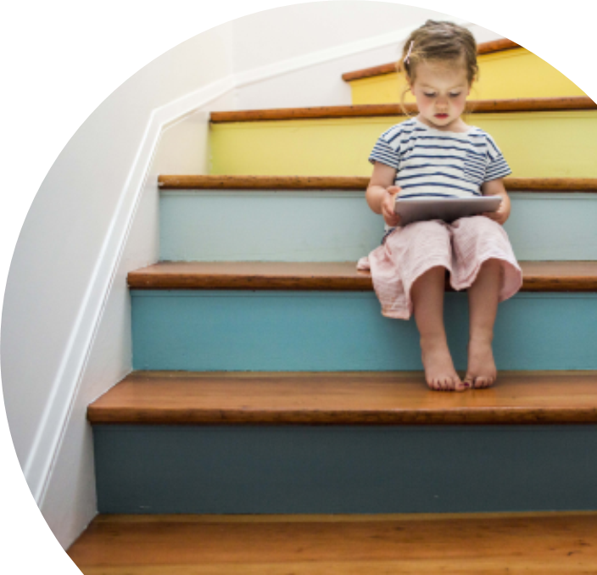
Summary
With PowerPoint, you can create presentations and share your work with others, wherever they are. Type the text you want here to get started. You can also add images, art, and videos on this template. Save to OneDrive and access your presentations from your computer, tablet, or phone.

Slide 17
Thank you

